Slide 1

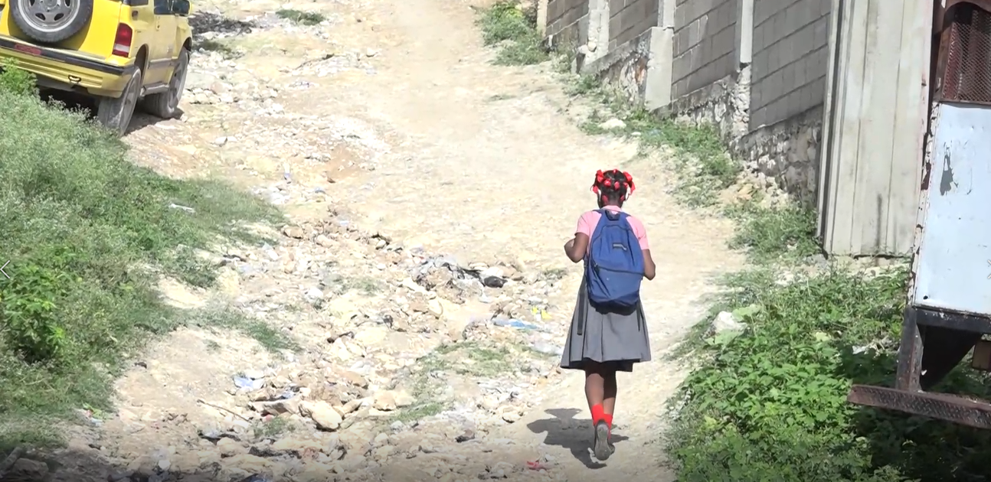



Slide 2
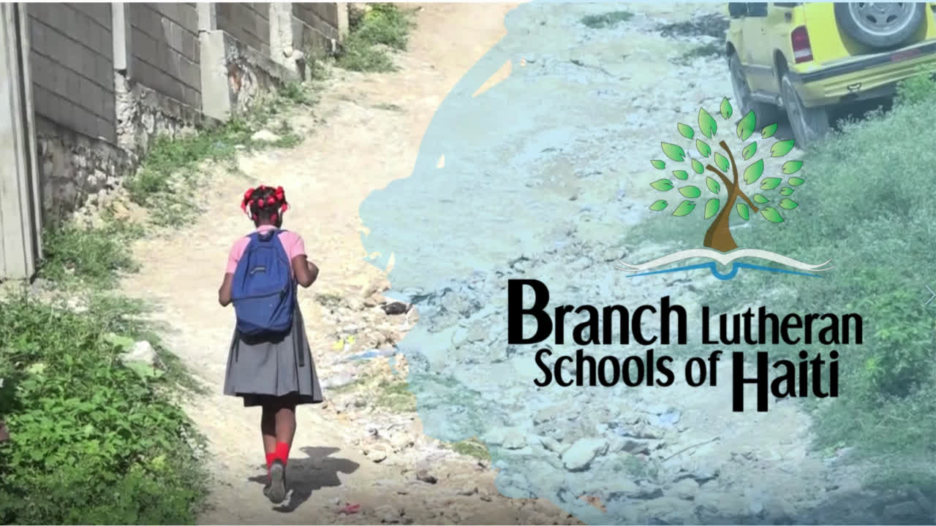

Slide 3
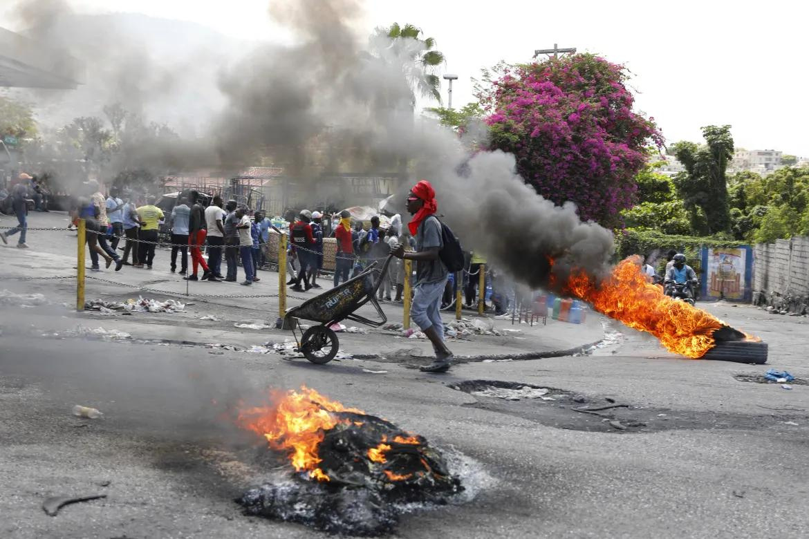



SIGNIFICANT CHALLENGES
GANGS HAVE INTENSIFIED THEIR RAMPAGE IN THE DOWNTOWN AREA OF HAITI’S CAPITAL, SETTING FIRE TO A SCHOOL AND LOOTING PHARMACIES
POLITICAL -
Gang violence, lack of security, government
INFLATION -
Costs often double or triple, even daily
AP News, March 26, 2024
FOOD -
Supply issues, danger of travel
HEALTH -
Cholera outbreak, lack of access
RETENTION -
School closures result in uneven learning
VODOU -
”Haiti is 30% Protestant, 70% Catholic, and 100% Vodou”

Slide 4
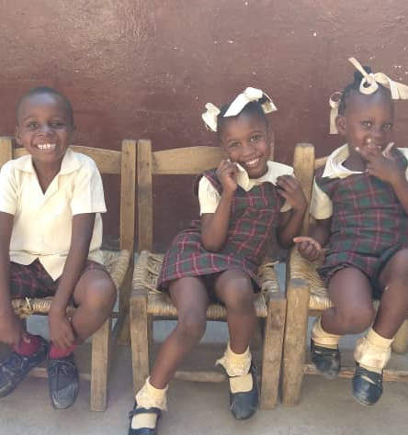

The security we have in Jesus does not mean the absence of danger, but rather, His presence in this danger.
Director Boursiquot, May 2024

Slide 5
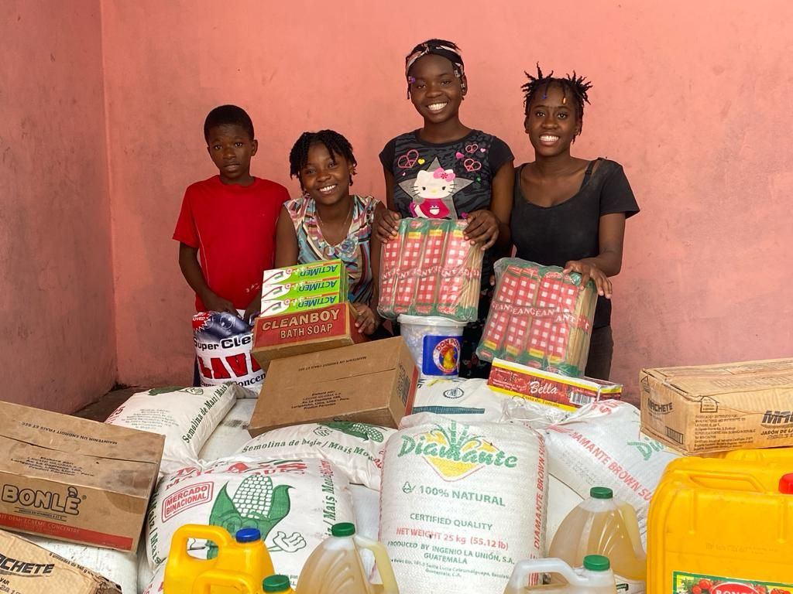
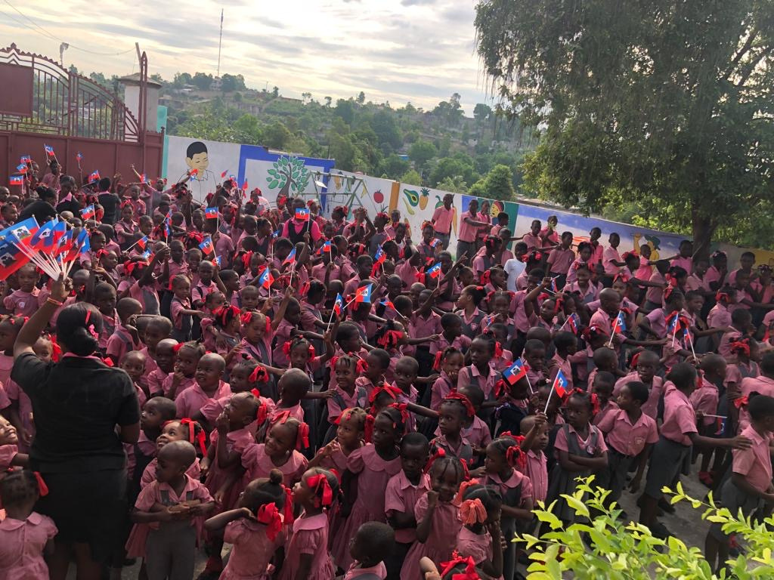

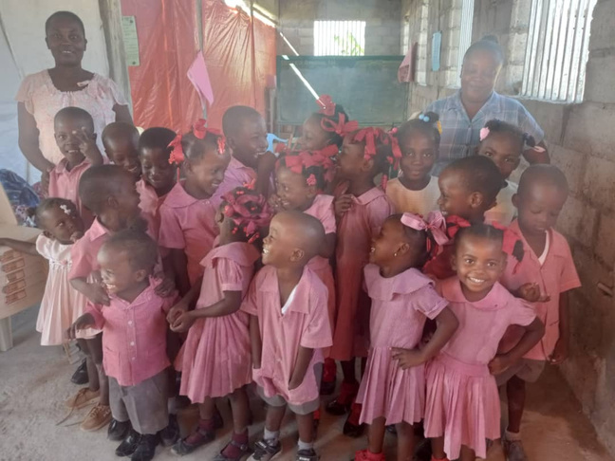
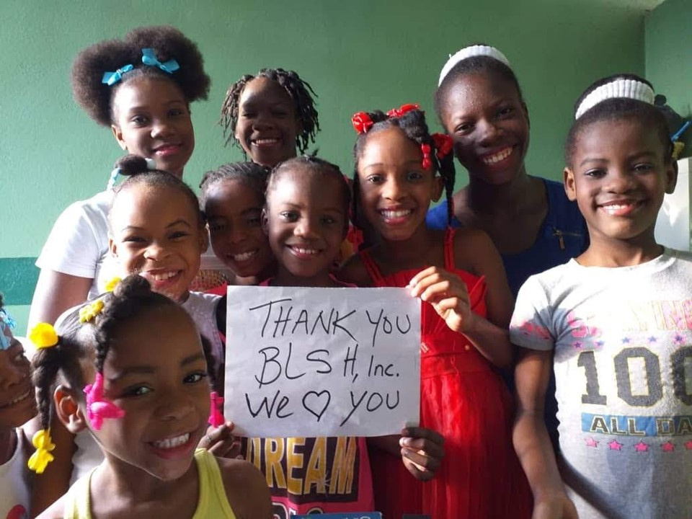
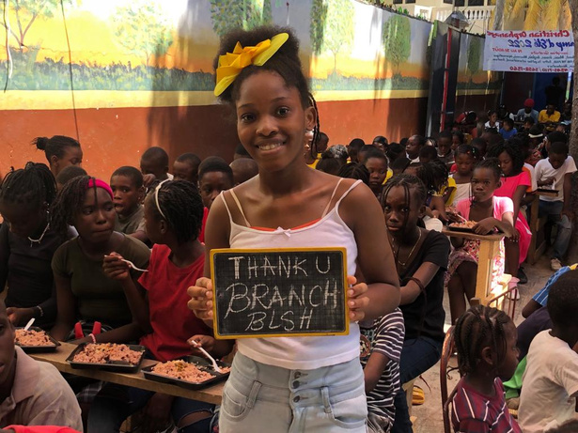
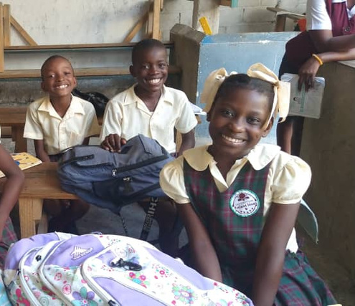
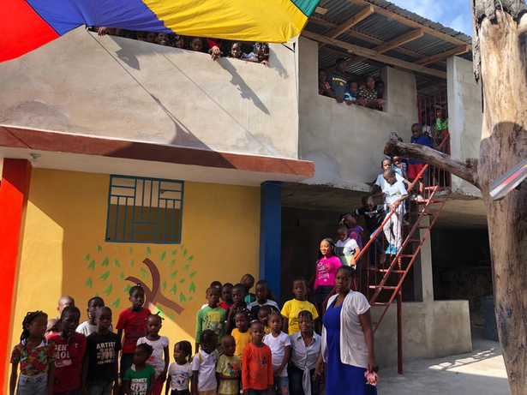
THE SCHOOLS
3 ELEMENTARY, 2 PRE/K, 1 MIDDLE

Slide 6






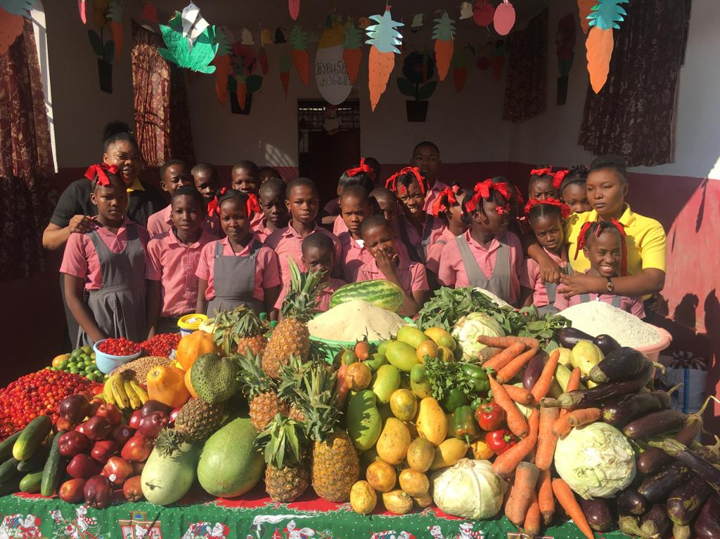

HOW CAN YOU HELP?
PRAY
SHARE
INFO
SPEAKER

Slide 7

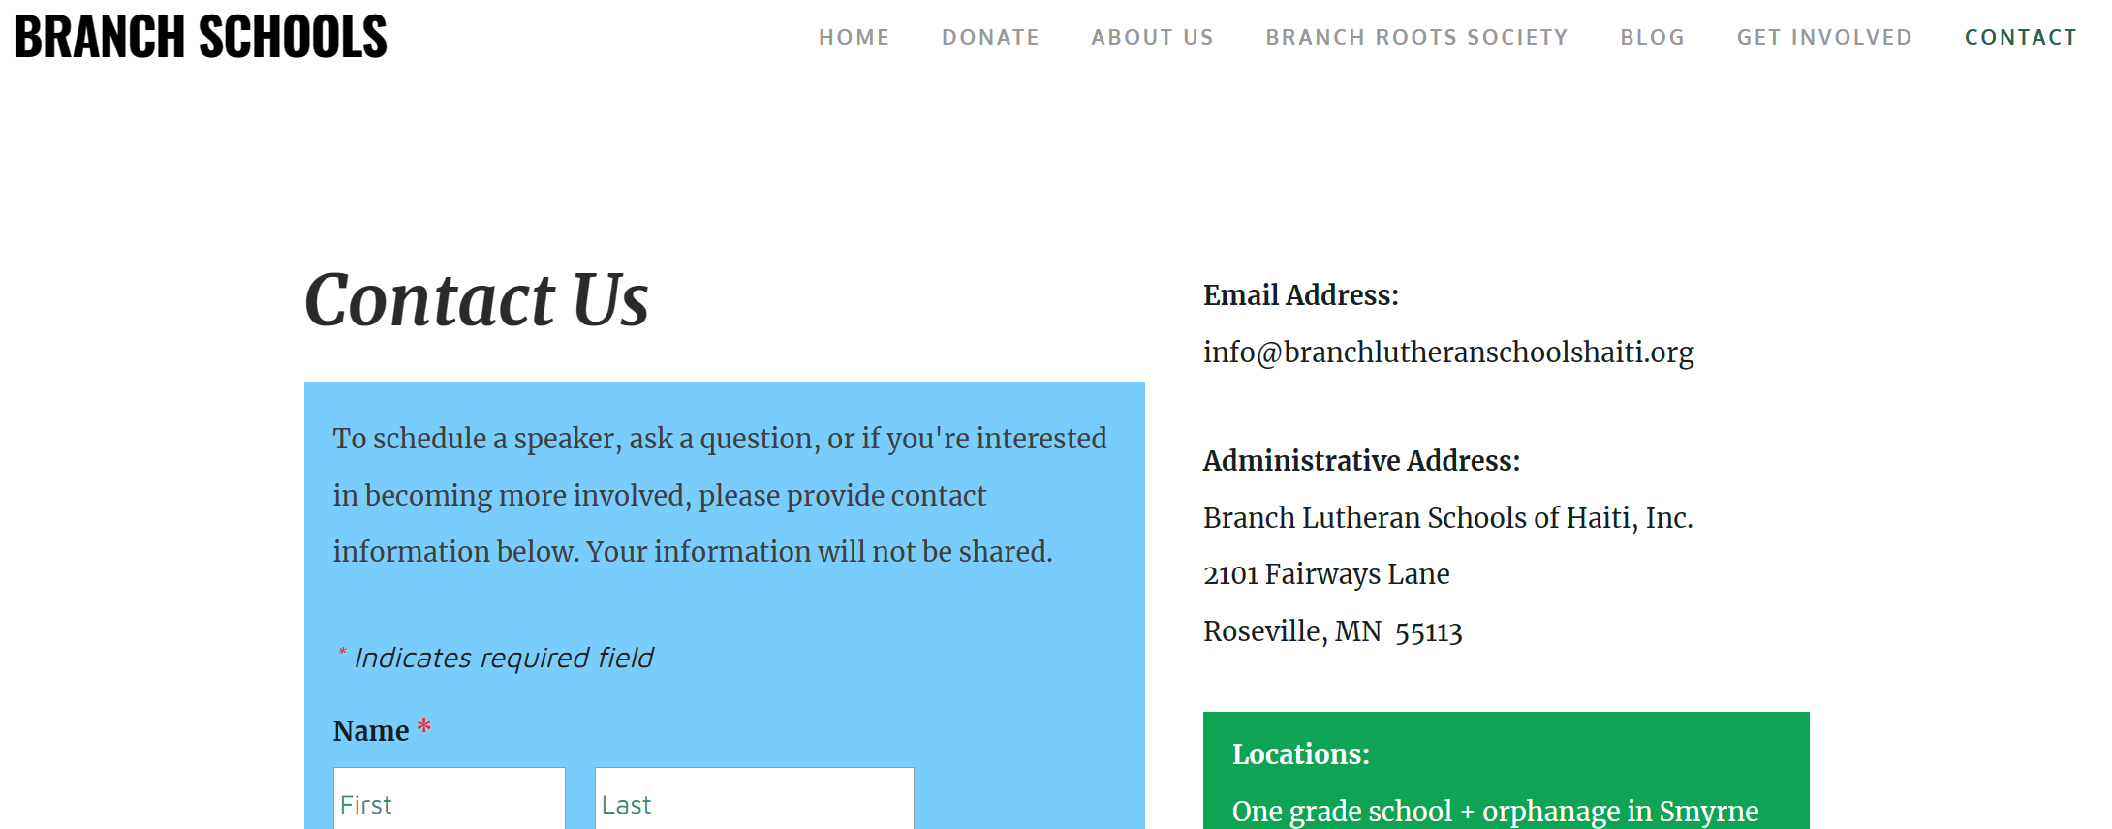
branchlutheranschoolshaiti.org

Slide 8



Thank You!
www.branchlutheranschoolshaiti.org
info@branchlutheranschoolshaiti.org

